Slide 1
Intro to Web Development
Day 3 PPAB Divkom

Slide 2
Web development, apa aja sih?
Front-end Developer
Bertanggung jawab pada bagian web yang langsung dirasakan pengguna. Misal layout, desain, dan lain lain.
Back-end Developer
Bertanggung jawab pada layanan yang berjalan dibelakang layar. Mengurus aplikasi, server, dan database.
Fullstack Developer
Bisa berkerja di Front-end dan Back-end sekaligus.
Notes:
Front end -> yang cantik2, bikin UI, entah yang desain di photoshop (desainer) sama yang implemen pake kode (developer) bisa dibilang front end.
Back-end -> Mengolah, meyimpan, dan memberikan kembali akses ke data yang disimpan
Fullstack -> Bisa keduanya, tapi bukan berarti harus master keduanya sekaligus. Tapi memiliki pemahaman yang cukup untuk berkerja di front end dan backend sekaligus

Slide 3


Apa saja yang dibutuhkan?
Text editor
Browser
Kemauan
VSCode, Sublime Text, Atom, dll
Chrome atau Firefox

Slide 4
Apa saja yang dibutuhkan?
HTML / CSS
Pertama dan utama. Keduanya digunakan di semua website.
Yang penting dipelajari :
Membuat desain dengan HTML dan CSS
Mengerti box model html
Penggunaan FlexBox & CSS Grid
Membuat halaman yang responsif
Notes:
HTML untuk kerangka, CSS untuk mempercantik. Buat front-end nih B)

Slide 5
Apa saja yang dibutuhkan?
Javascript
Javascript digunakan untuk menambah interaksi dinamis pada website
Dapat digunakan di frontend, tapi dengan NodeJS, bisa digunakan pada backend.
Yang perlu dikuasai
Vanilla Javascript
Manipulasi DOM, event
JSON (javascript object notation)
ES2015+
Notes:
HTML untuk kerangka, CSS untuk mempercantik. Buat front-end nih B)

Slide 6
HTML The Skeleton of Our Website
Finally, no more story please, let’s get into the real thing!

Slide 7
What is HTML
HTML is not a programming language!
HTML consist of several element that structures your webpage.
For, example we want to display this as one stand line
My cat is very grumpy
In HTML, we could specify the sentence as paragraph by enclosing it in paragraph tags
<p> My cat is very grumpy </p>

Slide 8
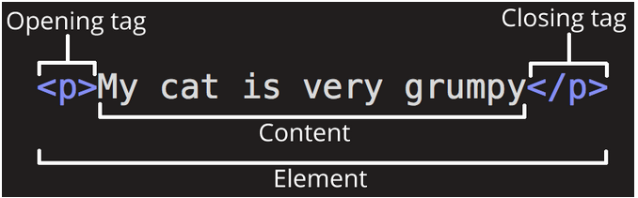
Dissecting the HTML
Notes:
The opening tag: berisi nama elemen, menandakan kapan elemen dimulai (dalam kasus ini paragraph dimulai)
The closing tag: sama dengan opening tag, tapi ditambah forward slash, menandakan kapan elemen berakhir. Biasanya pemula suka lupa kasih closing tag, hasilnya ya jadi lucu.
The content: This is the content of the element, which in this case is just text.
The element: The opening tag, the closing tag, and the content together comprise the element.

Slide 9

Adding some Attributes
Notes:
Attribute digunakan untuk menyimpan informasi tambahan tentang elemen yang tidak ingin kita tampilkan pada webpage. Dalam kasus ini, class adalah nama attribute, dan editor-note adalah value dari attribute. Attribute dapat digunakan sebagai identifier untuk menargetkan elemen dalam styling nanti

Slide 10


Nesting Attribute
Correct
Incorrect
Notes:
Jangan lupa tagnya harus ngurut nutupnya

Slide 11
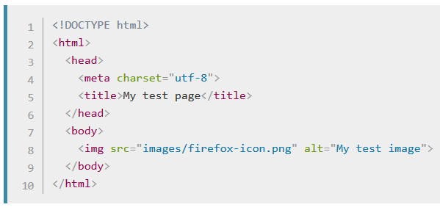
Anatomy of a HTML Document
Notes:
<!DOCTYPE html> — the doctype: Tambahin aja, konvensi lama di HTML. Ada sejarahnya tapi ga penting-penting amat.
<html></html> -- Biasanya disebut root element, seluruh sintaks html kita harus ada di dalam tag ini
<head></head> -- Container dari seluruh element html yang bukan bagian dari konten yang ingin disajikan pada web. Contohnya metadata kaya page description, tag, script, dll
<meta charset="utf-8"> -- Elemen ini ngatur supaya dokumennya pakai konvensi UTF-8. Salah satu konvensi juga. Soalnya kebanyakan karakter sudah include pakai ini.
<title></title> -- Elemen ini ngatur judul halaman
<body></body> -- Elemen ini isinya konten yang pengen disajikan, contohnya tulisan, image, video, dll

Slide 12
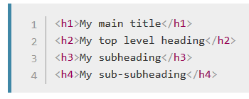
Marking Text: Header
Notes:
Maksimal header 6.

Slide 13

Marking Text: Paragraph

Slide 14
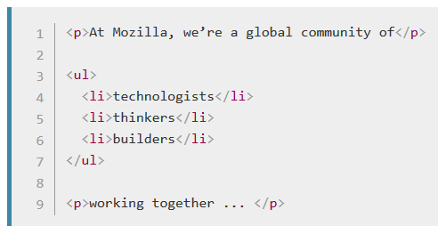
Marking Text: List
Notes:
Ada dua macam list ordered <ol> sama unordered <ul>.

Slide 15
Input type
Notes:
href = remember that it stands for hypertext reference.
You might get unexpected results if you omit the https:// or http:// part, called the protocol, at the beginning of the web address. After making a link, click it to make sure it is sending you where you wanted it to

Slide 16
CSS The Skin of Our Website
Let’s style our Website!

Slide 17
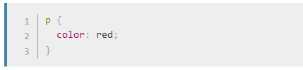
What is CSS
CSS is also not a programming language!
CSS consist of several element that style your website.
For, example we want to display this paragraph as red colored text
<p> My cat is very grumpy </p>
In CSS, we could specify the paragraph by selecting it and apply some style.

Slide 18

What is CSS
After that, save the code into `styles/style.css`
Open your `index.html` and add this line to the <head></head> tag
Save `index.html` and refresh!
Or you could write directly at HTML

Slide 19
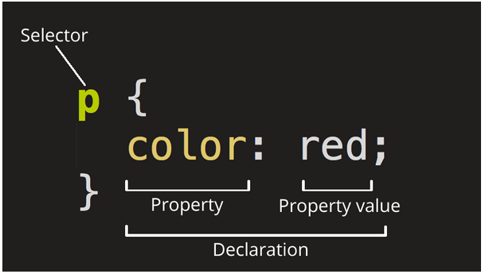
Dissecting the CSS
Notes:
Selector: The HTML element name at the start of the rule set. It selects the element(s) to be styled (in this case, p elements). To style a different element, just change the selector. Declaration: A single rule like color: red; specifying which of the element's properties you want to style.
Properties: Ways in which you can style a given HTML element. (In this case, color is a property of the <p> elements.) In CSS, you choose which properties you want to affect in your rule.
Property value: To the right of the property after the colon, we have the property value, which chooses one out of many possible appearances for a given property (there are many color values besides red).

Slide 20
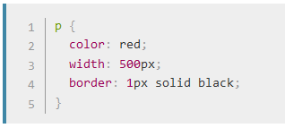
Multiple Rules
Notes:
Also some basic rule:
Each rule set (apart from the selector) must be wrapped in curly braces ({}).
Within each declaration, you must use a colon (:) to separate the property from its values.
Within each rule set, you must use a semicolon (;) to separate each declaration from the next one.

Slide 21

Selecting Multiple Element

Slide 22
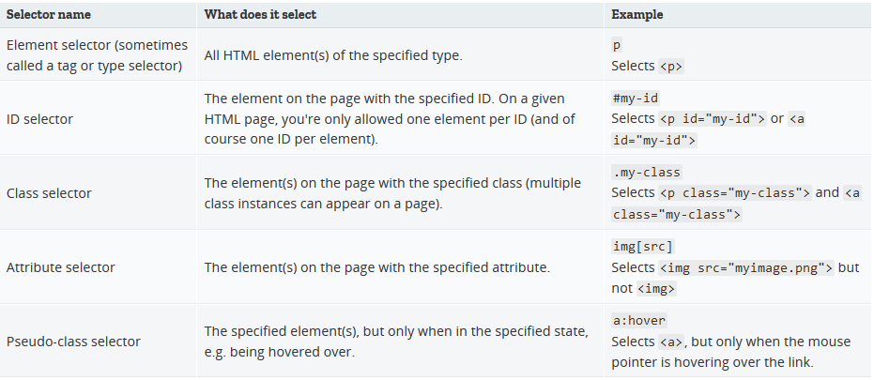
More Selector

Slide 23
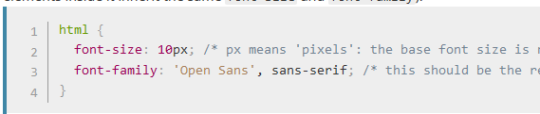
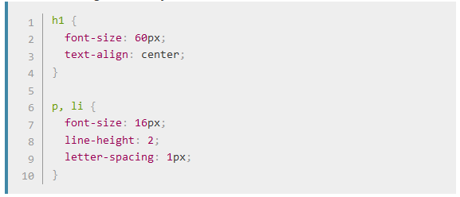
Font and Text
Create new style.css (delete the red paragraph from before)
We will also stylize header and list

Slide 24
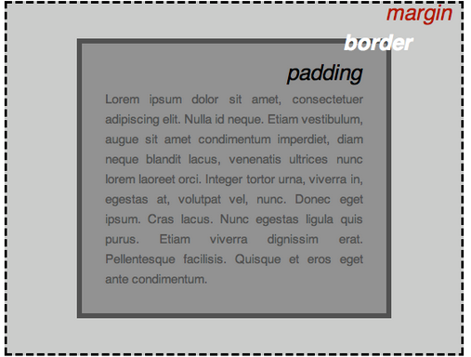
CSS is all about Boxes
Notes:
padding, the space just around the content (e.g., around paragraph text)
border, the solid line that sits just outside the padding
margin, the space around the outside of the element
In this section we also use:
width (of an element)
background-color, the color behind an element's content and padding
color, the color of an element's content (usually text)
text-shadow: sets a drop shadow on the text inside an element
display: sets the display mode of an element (don't worry about this yet)

Slide 25
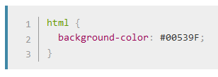
Changing Page Color
Notes:
padding, the space just around the content (e.g., around paragraph text)
border, the solid line that sits just outside the padding
margin, the space around the outside of the element

Slide 26
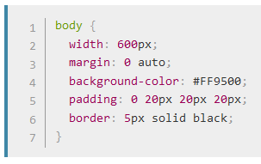
Sorting the Body Out
Notes:
width: 600px; — this forces the body to always be 600 pixels wide.
margin: 0 auto; — When you set two values on a property like margin or padding, the first value affects the element's top and bottom side (make it 0 in this case), and the second value the left and right side (here, auto is a special value that divides the available horizontal space evenly between left and right). You can also use one, three, or four values, as documented here.
background-color: #FF9500; — as before, this sets the element's background color. We've used a sort of reddish orange for the body as opposed to dark blue for the <html> element, but feel free to go ahead and experiment.
padding: 0 20px 20px 20px; — we have four values set on the padding, to make a bit of space around our content. This time we are setting no padding on the top of the body, and 20 pixels on the left, bottom and right. The values set top, right, bottom, left, in that order.
border: 5px solid black; — this simply sets a 5-pixel–wide, solid black border on all sides of the body.

Slide 27
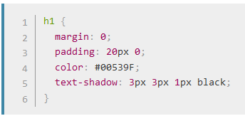
Positioning and Styling our Title
Notes:
To get rid of the top gap of H1 we overrode the default styling by setting margin: 0;.
Next up, we've set the heading's top and bottom padding to 20 pixels, and made the heading text the same color as the html background color.
Text Shadow:
The first pixel value sets the horizontal offset of the shadow from the text — how far it moves across: a negative value should move it to the left.
The second pixel value sets the vertical offset of the shadow from the text — how far it moves down, in this example; a negative value should move it up.
The third pixel value sets the blur radius of the shadow — a bigger value will mean a more blurry shadow.
The fourth value sets the base color of the shadow.

Slide 28
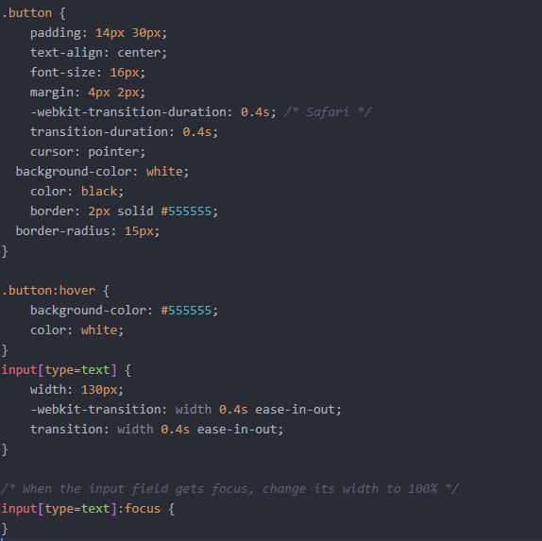
Input Styling

Slide 29




Javascript : syntax dasar Variabel
Declaring Variable
Defining Variable
Both at the same line
Accessing Variable

Slide 30
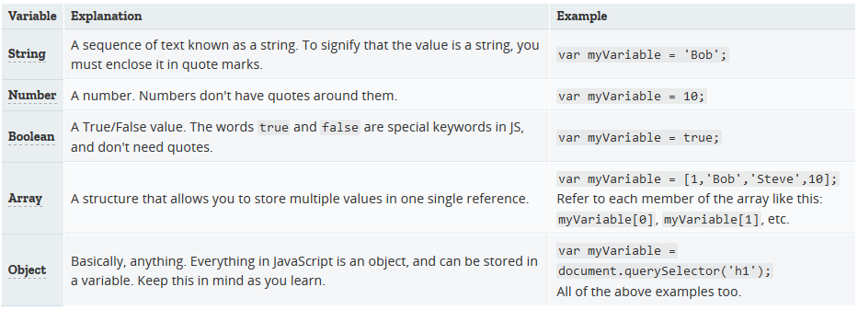
Javascript : syntax dasar Variabel

Slide 31
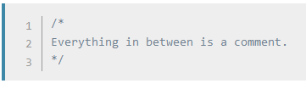

Javascript : syntax dasar Komentar

Slide 32
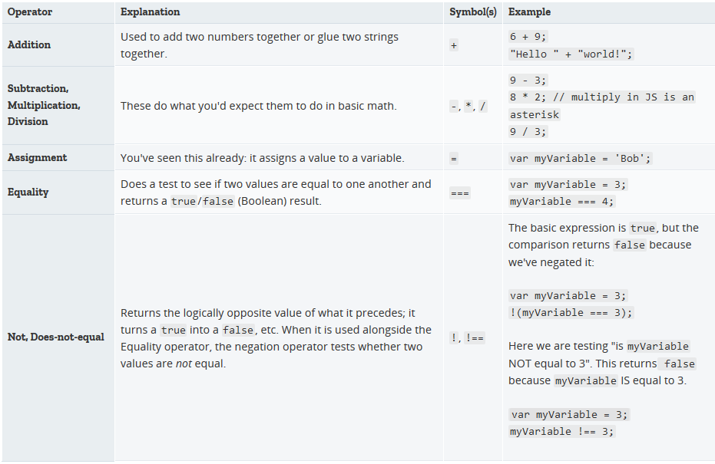
Javascript : syntax dasar Operator

Slide 33
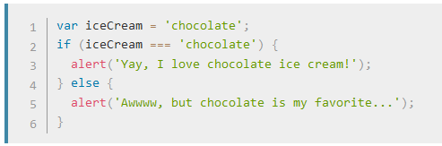
Javascript : syntax dasar Percabangan

Slide 34
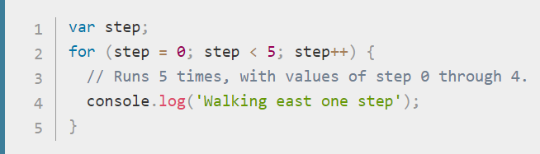
Javascript : syntax dasar Perulangan

Slide 35
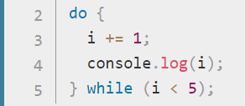
Javascript : syntax dasar Perulangan

Slide 36
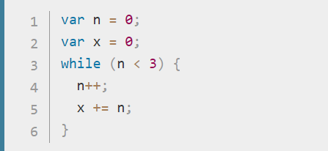
Javascript : syntax dasar Perulangan

